Slide 1
Upgrade Firmware
Through J-Link

Slide 2
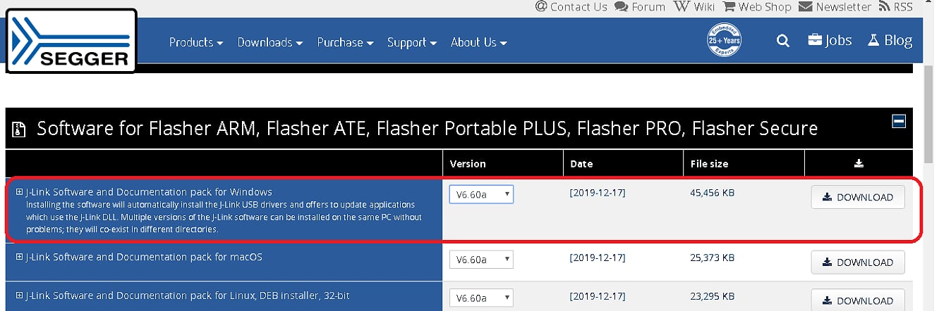
Step 1
Download Segger Softwae Package v6.60B https://www.segger.com/downloads/jlink/

Slide 3
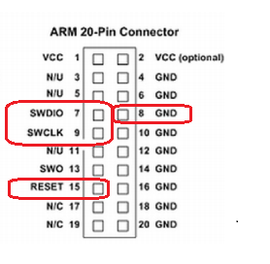
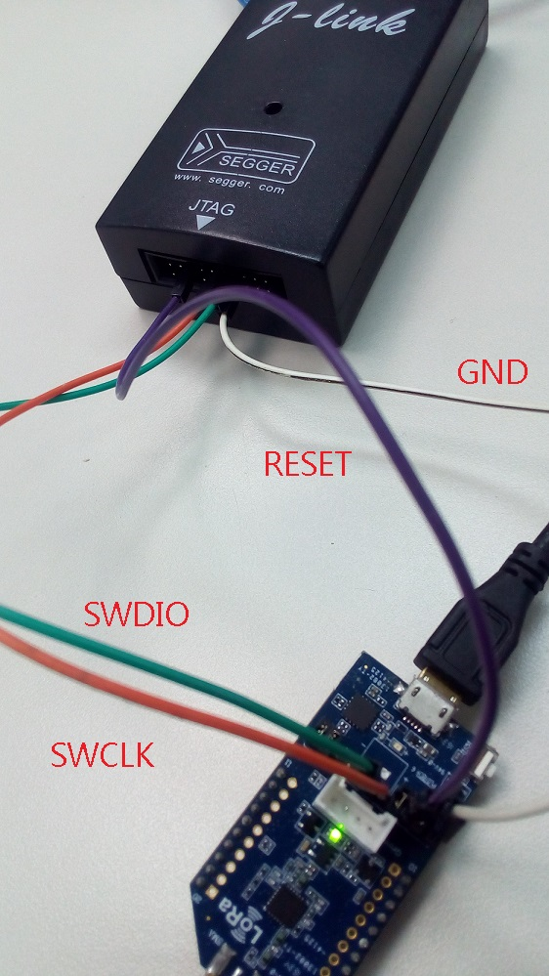
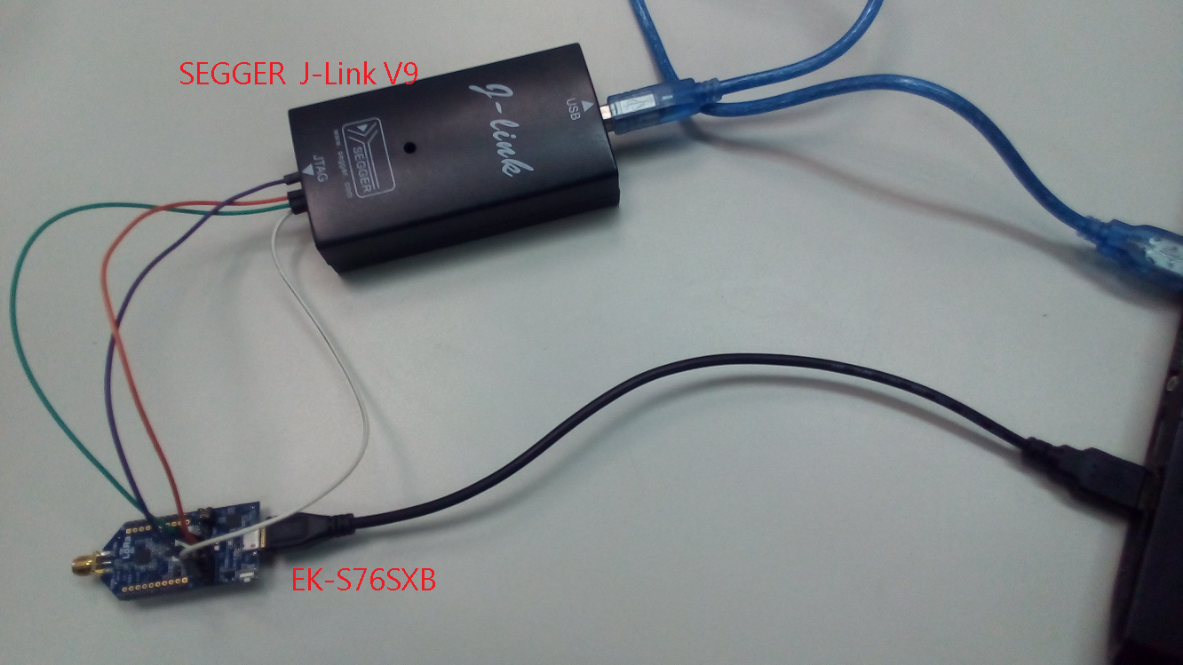
Step 2
Connect S76S / S68S / S76G S78G to J-link through SWD interface
SWCLK/SWDIO/RESET/GND

Slide 4
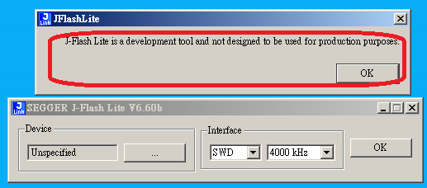
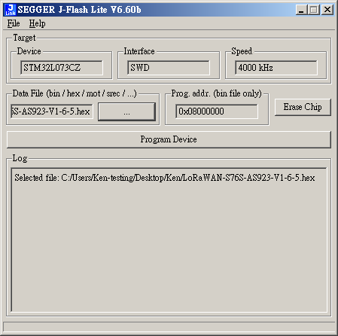
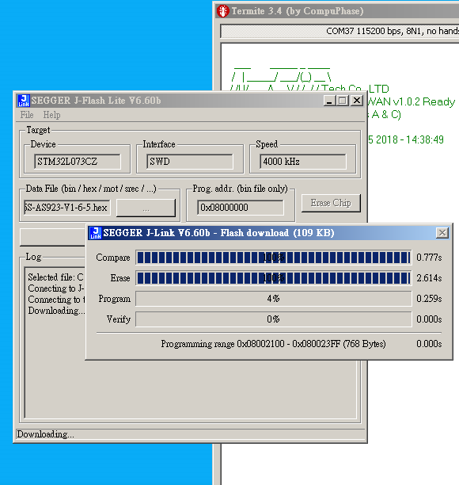
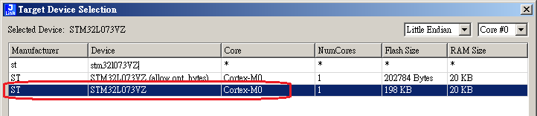
Step 3 choose device->choose firmware-> Program Device
Choose firmware file＿
Device:STM32L073VZ

Slide 5
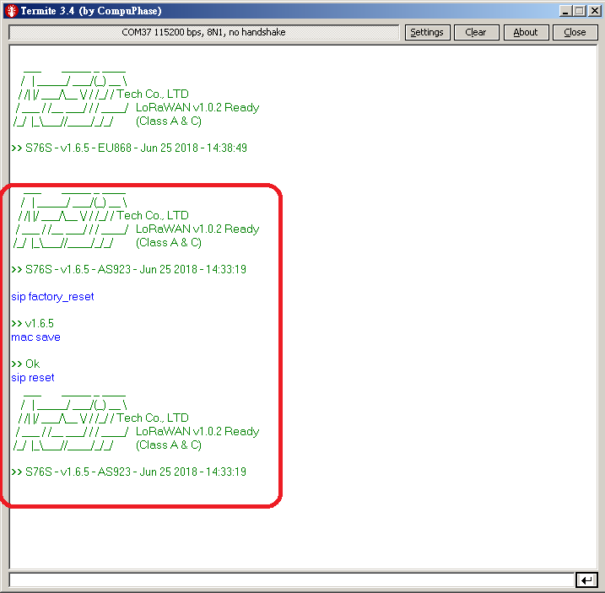
Step 4
After Firmware Update
Please run
sip factory_reset
mac save
sip reset

